Slide 1
Distributed Termination
Presented by Hugo Huipet
Francez, N. (1980). Distributed termination. ACM Transactions on Programming Languages and Systems (TOPLAS), 2(1), 42-55.

Slide 2
Paper Contributions
Present an algorithm to address the distributed termination problem of Distributed systems based on communication among disjoint processes
Exposition Contribution
Set the initial background around the distributed termination problem and solve the sorted partition problem with the algorithm presented in this paper

Slide 3
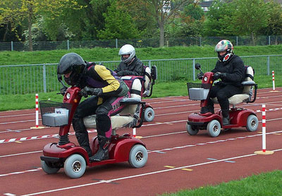
Context: 1980
New programming language for concurrent programming: CSP (Hoare).
Processes: Disjoint → no variable sharing
Communication/synchronization by I/O
Theoretical Problems → i.e. Distributed Termination

Slide 4
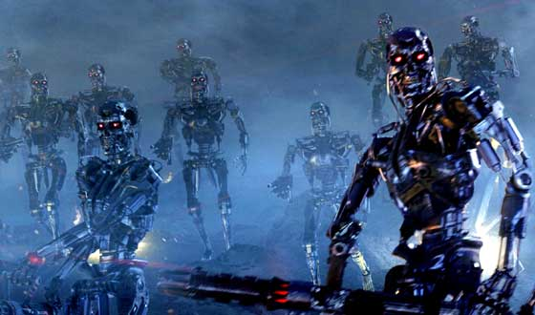
What is Distributed Termination?
To achieve global termination of a concurrent program given that individual processes have limited information about others connected to them
Distribute the decision to terminate HARD
Distribute global post-condition EASY

Slide 5
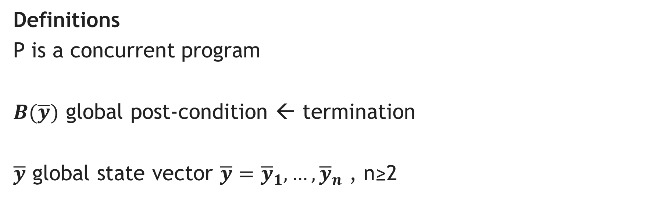
Problem
Definitions
P is a concurrent program
$B(\overline{y})$ global post-condition ← termination
$\overline{y}$ global state vector $\overline{y}={\overline{y}}_{1},…,{\overline{y}}_{n}$ , n≥2

Slide 6
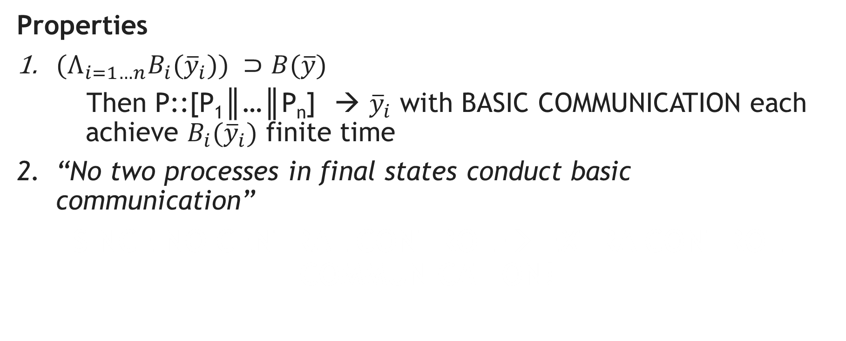
Problem
Properties
${(Λ}_{i=1…n}B_{i}({\overline{y}}_{i})) ⊃B(\overline{y})$
Then P::[P₁║…║P_{n}] → ${\overline{y}}_{i}$ with BASIC COMMUNICATION each achieve $B_{i}({\overline{y}}_{i})$ finite time
“No two processes in final states conduct basic communication”
SINCE NO CENTRAL CONTROL → EXTRA CONTROL COMMUNICATION!

Slide 7
Sorted Partition Example
Let S a non empty set of natural numbers (NO-REPS)
S
S
?
47
20
55
98
20
47
65
98
76
65
44
44
55
76

Slide 8
Sorted Partition Example
S = S1+…+Sn disjoint partition n ≥ 2
Final state: Each subset maintains same number of elements, and each partition sorted ASCENDING order
Basic Communication: Send or receive a natural number
S₃
S₁
S₂
47
20
98
76
44
65
55

Slide 9

Sorted Partition Example
lin_{i} the last input from right neighbor (i+1)
The Final State: B_{i}(S_{i}, lin_{i}) $≡$ max (S_{i}) ≤ lin_{i} & S_{i} = |m_{i}| for 1 ≤ i < n
S₃
S₁
lin:
S₂
lin:
47
20
lin:
98
76
44
65
55

Slide 10
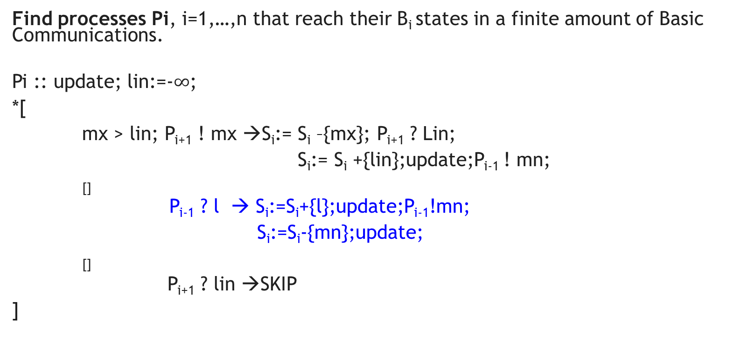
Sorted Partition Example
Find processes Pi, i=1,…,n that reach their B_{i} states in a finite amount of Basic Communications.
Pi :: update; lin:=-$∞$;
*[
mx > lin; P_{i+1} ! mx →S_{i}:= S_{i} –{mx}; P_{i+1} ? Lin;
S_{i}:= S_{i} +{lin};update;P_{i-1} ! mn;
[]
P_{i-1} ? l → S_{i}:=S_{i}+{l};update;P_{i-1}!mn;
S_{i}:=S_{i}-{mn};update;
[]
P_{i+1} ? lin →SKIP
]
update:
[mx:=max(Si); mn:=min(Si)]
1
2
P₁ only has Black code
3
P_{n} only has Blue code

Slide 11

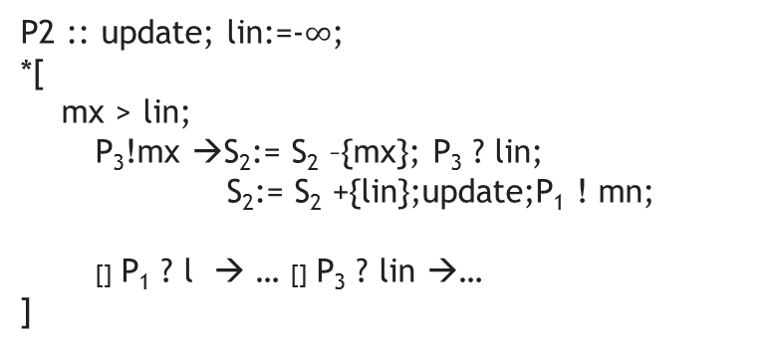


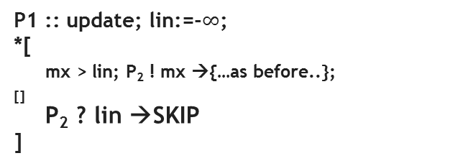

Sorted Partition Example
WAITING for lin ← P₃
S₃
S₁
44
S₂
$$−∞$$
lin:
lin:$−∞$
44
47
20
lin:
$$−∞$$
65
98
76
44
44
65
55
mx: 76
mn: 20
mx:
mn:
55
mx:
mn:
98
65
44
44
65
65
44
44
55
P1 :: update; lin:=-$∞$;
*[
mx > lin; P₂ ! mx →{…as before..};
[]
P₂ ? lin →SKIP
]
P2 :: update; lin:=-$∞$;
*[
mx > lin;
P₃!mx →S₂:= S₂ –{mx}; P₃ ? lin;
S₂:= S₂ +{lin};update;P₁ ! mn;
[] P₁ ? l → … [] P₃ ? lin →…
]
P3 :: update; lin:=-$∞$;
*[
P₂ ? l → S₃:=S₃+{l};update; P₂!mn;
S₃:=S₃-{mn};update;
]

Slide 12
Sorted Partition Example
S₁
S₂
S₃
47
20
44
98
76
55
65
S₁
S₂
S₃
20
47
55
98
44
76
65
S₁
S₂
S₃
20
47
55
98
44
65
76

Slide 13
THANKS

